Slide 1
NOMAD collimator test
Yuanpeng Zhang
Neutron Scattering Division
Sep-09-2022

Slide 2
The following two sets of measurement were used for shifter testing,
May 2022 – June 2022
Full detector coverage
3D collimation: ROC 38-57, 8, 14, 27, 37
Diamond: 183699
MT PAC: 183701
Vrod: 183700
MT Shifter: 183704
January 2022 – May2022
Full detector coverage
Water-jetted, boron-loaded collimators: ROC 59, 63
3D collimation: ROC 60, 61, 62, 45, 46, 47, 32, 33, 34
Diamond: 168865
MT PAC: 168011
Vrod: 168012
MT Shifter: 168013

Slide 3
The following two sets of measurement were used for cryostat testing,
May 2022 – June 2022
Full detector coverage
3D collimation: ROC 38-57, 8, 14, 27, 37
Diamond: 182703
MT PAC: 182706
Vrod: 182704
MT Cryo: 182705
January 2022 – May2022
Full detector coverage
Water-jetted, boron-loaded collimators: ROC 59, 63
3D collimation: ROC 60, 61, 62, 45, 46, 47, 32, 33, 34
Diamond: 169417
MT PAC: 169403
Vrod: 169418
MT Cryo: 169419

Slide 4
The aim is to see the influence of collimator installation on certain eight-packs upon the data.
So, the test conducted here is,
Focusing on a certain eight-pack or a certain group of eight-packs, we mask out all detectors other than the eight-pack(s) under focus.
We align and focus the patterns for the eight-pack(s) under focus. Here, we take diamond sample as our standard and we output the following,
(Dia - MTC) / (Vrod – MT)
MTC, MT
MTC – MT, Vrod - MT, (MTC - MTC) / (Vrod – MT)
We conduct the identical set of processing above in parallel for measurements taken before and after the collimator (the 3D one) installation.

Slide 5
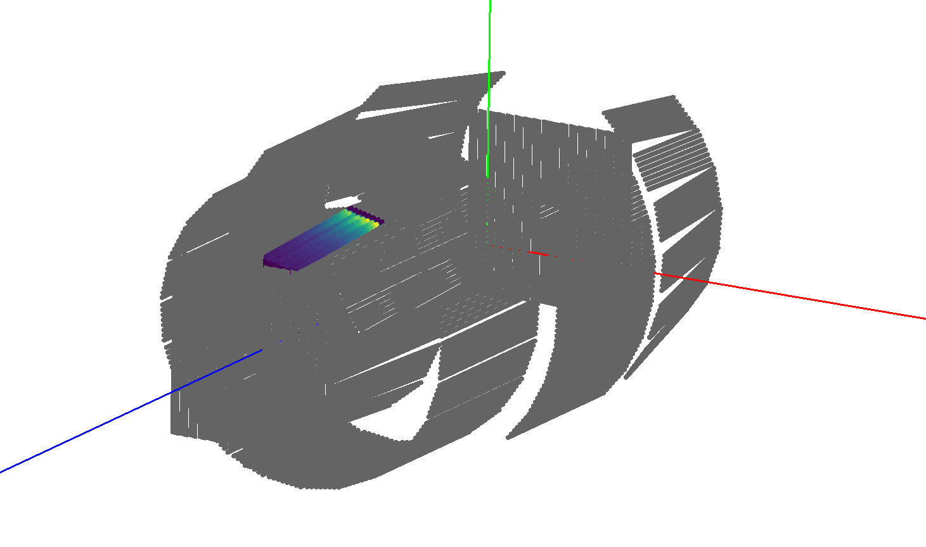
This is an example for the instrument view with all detects but the focused eight-pack masked

Slide 6
Shifter Results

Slide 7
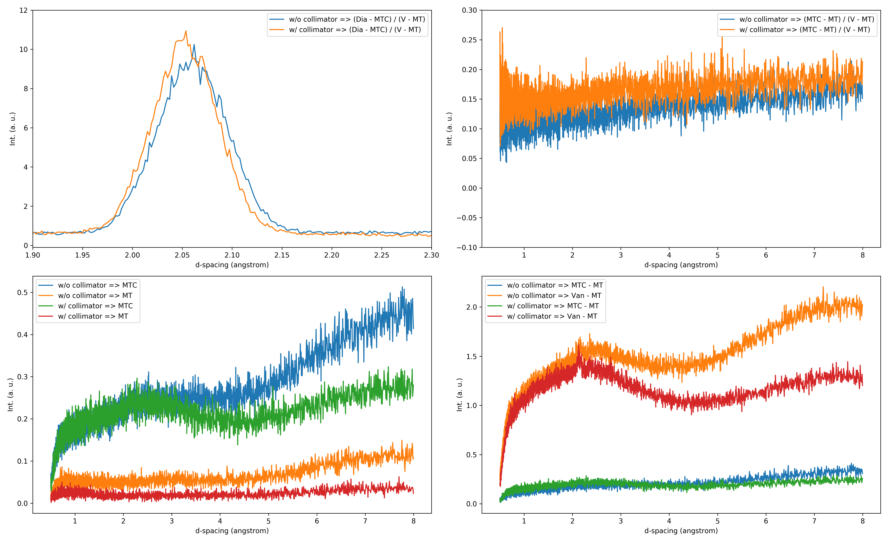
Focused eight-packs: #8 (bank-2)

Slide 8
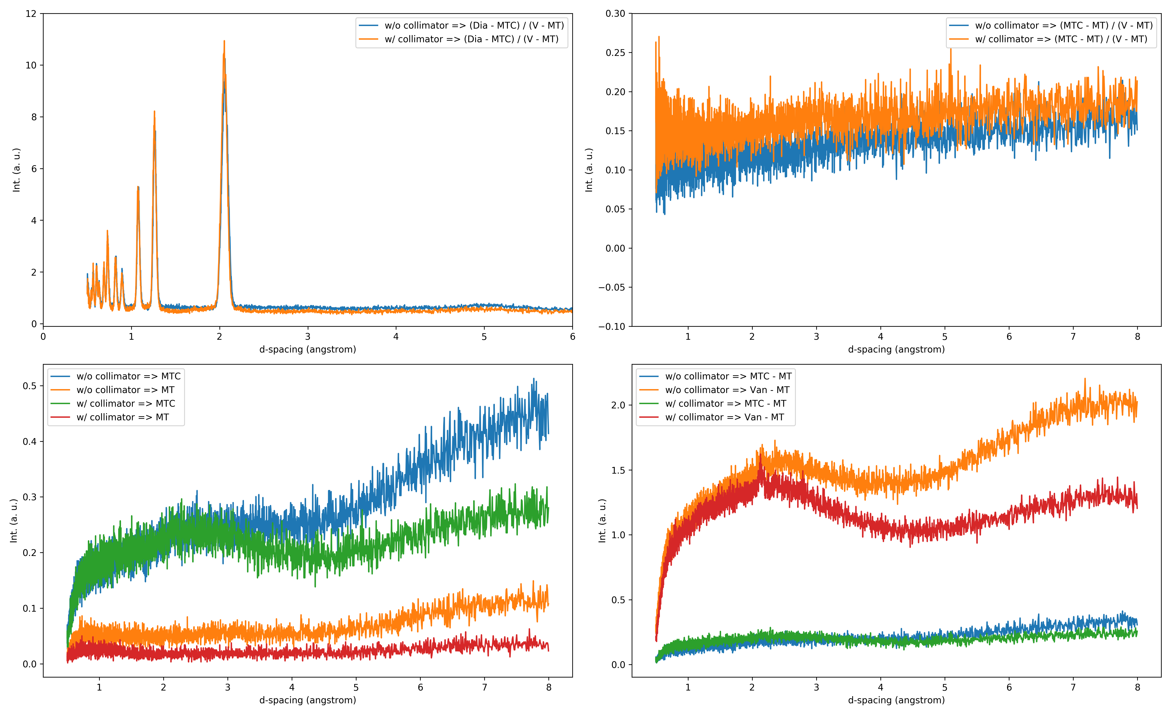
Focused eight-packs: #8 (bank-2)

Slide 9
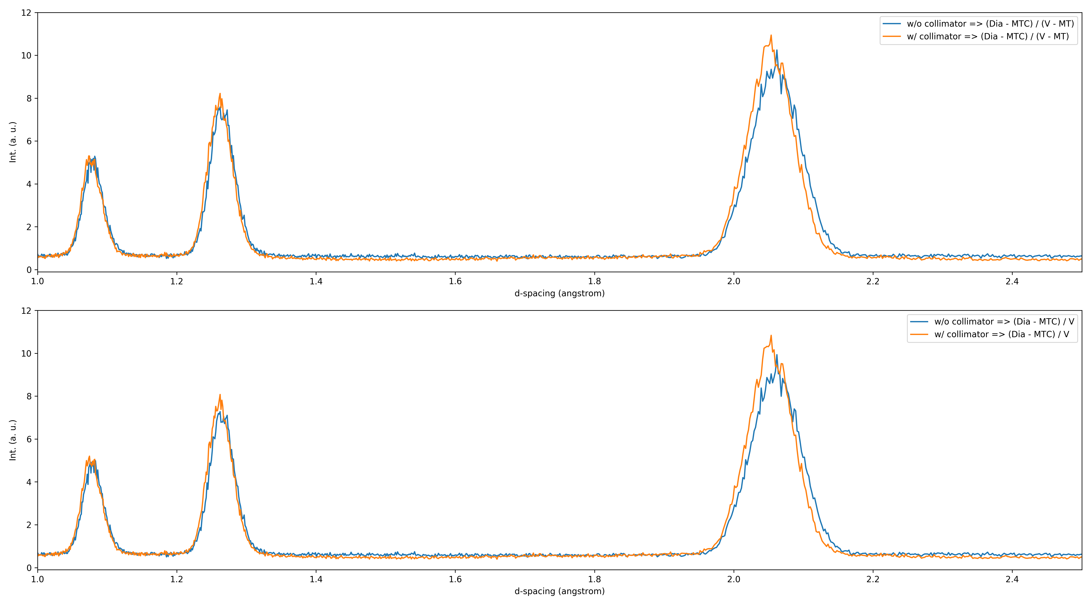
Focused eight-packs: #8 (bank-2)

Slide 10
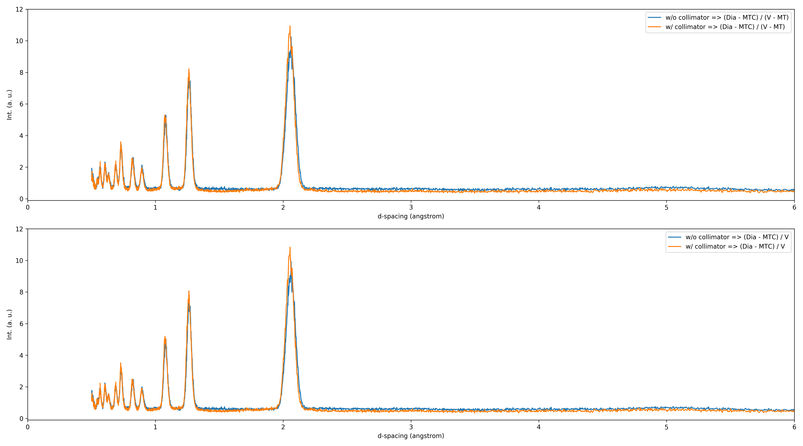
Focused eight-packs: #8 (bank-2)

Slide 11
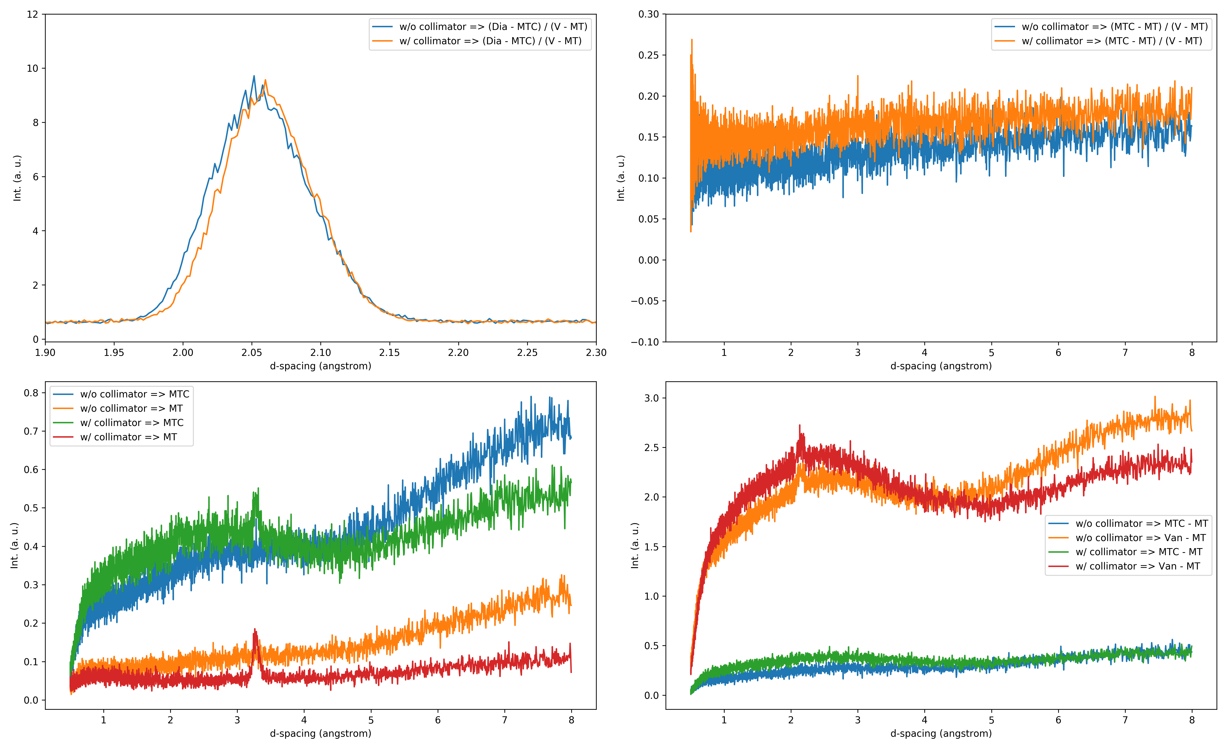
Focused eight-packs: #14 (bank-2)

Slide 12
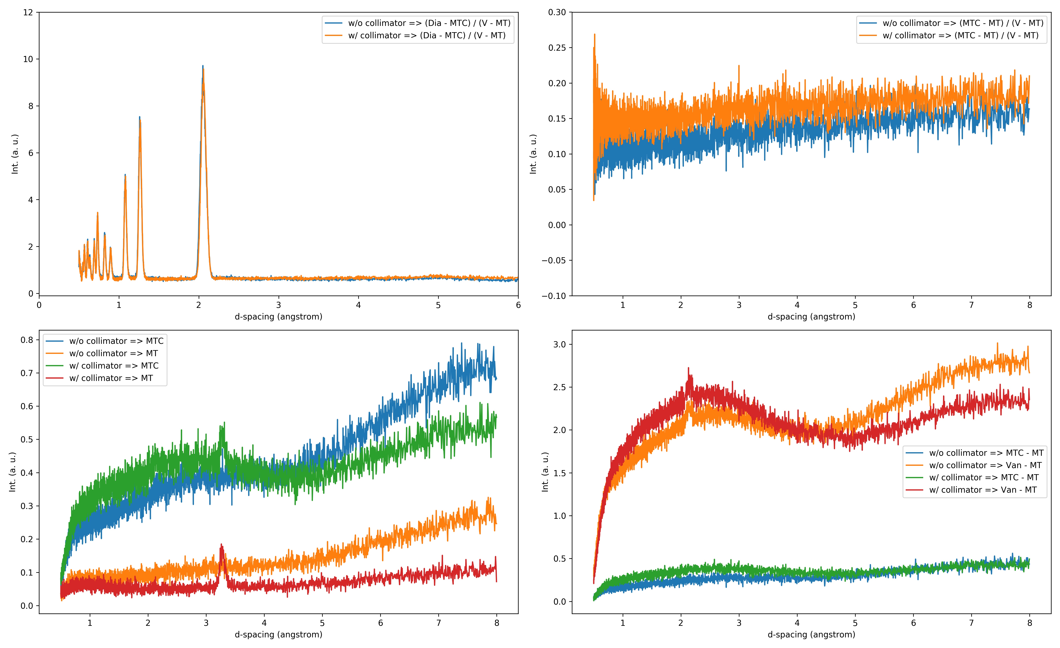
Focused eight-packs: #14 (bank-2)

Slide 13
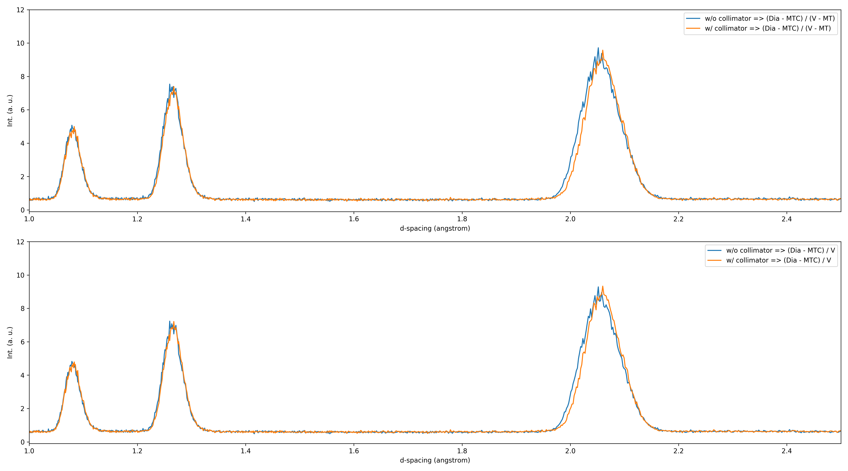
Focused eight-packs: #14 (bank-2)

Slide 14
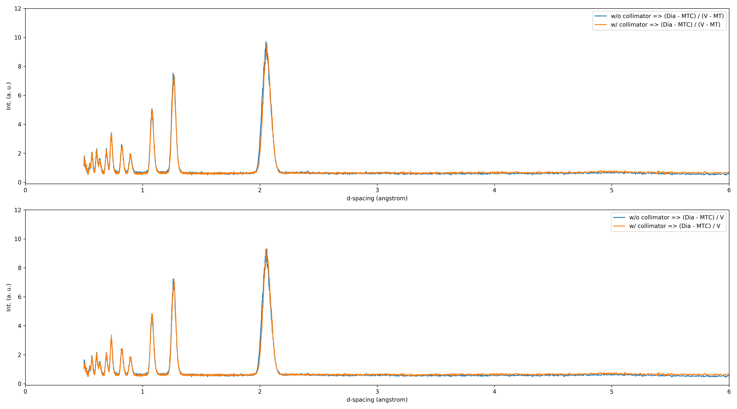
Focused eight-packs: #14 (bank-2)

Slide 15
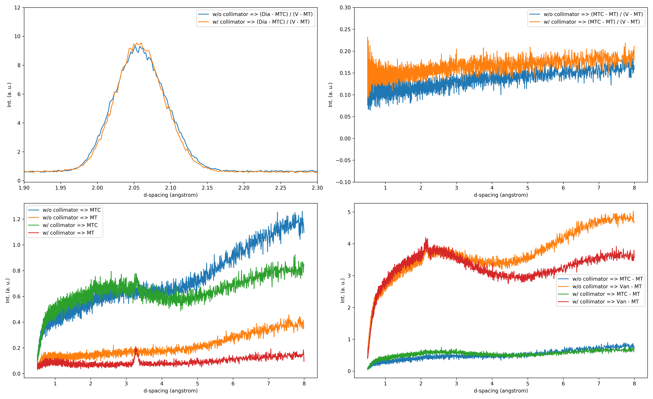
Focused eight-packs: #8 & #14 (bank-2)

Slide 16
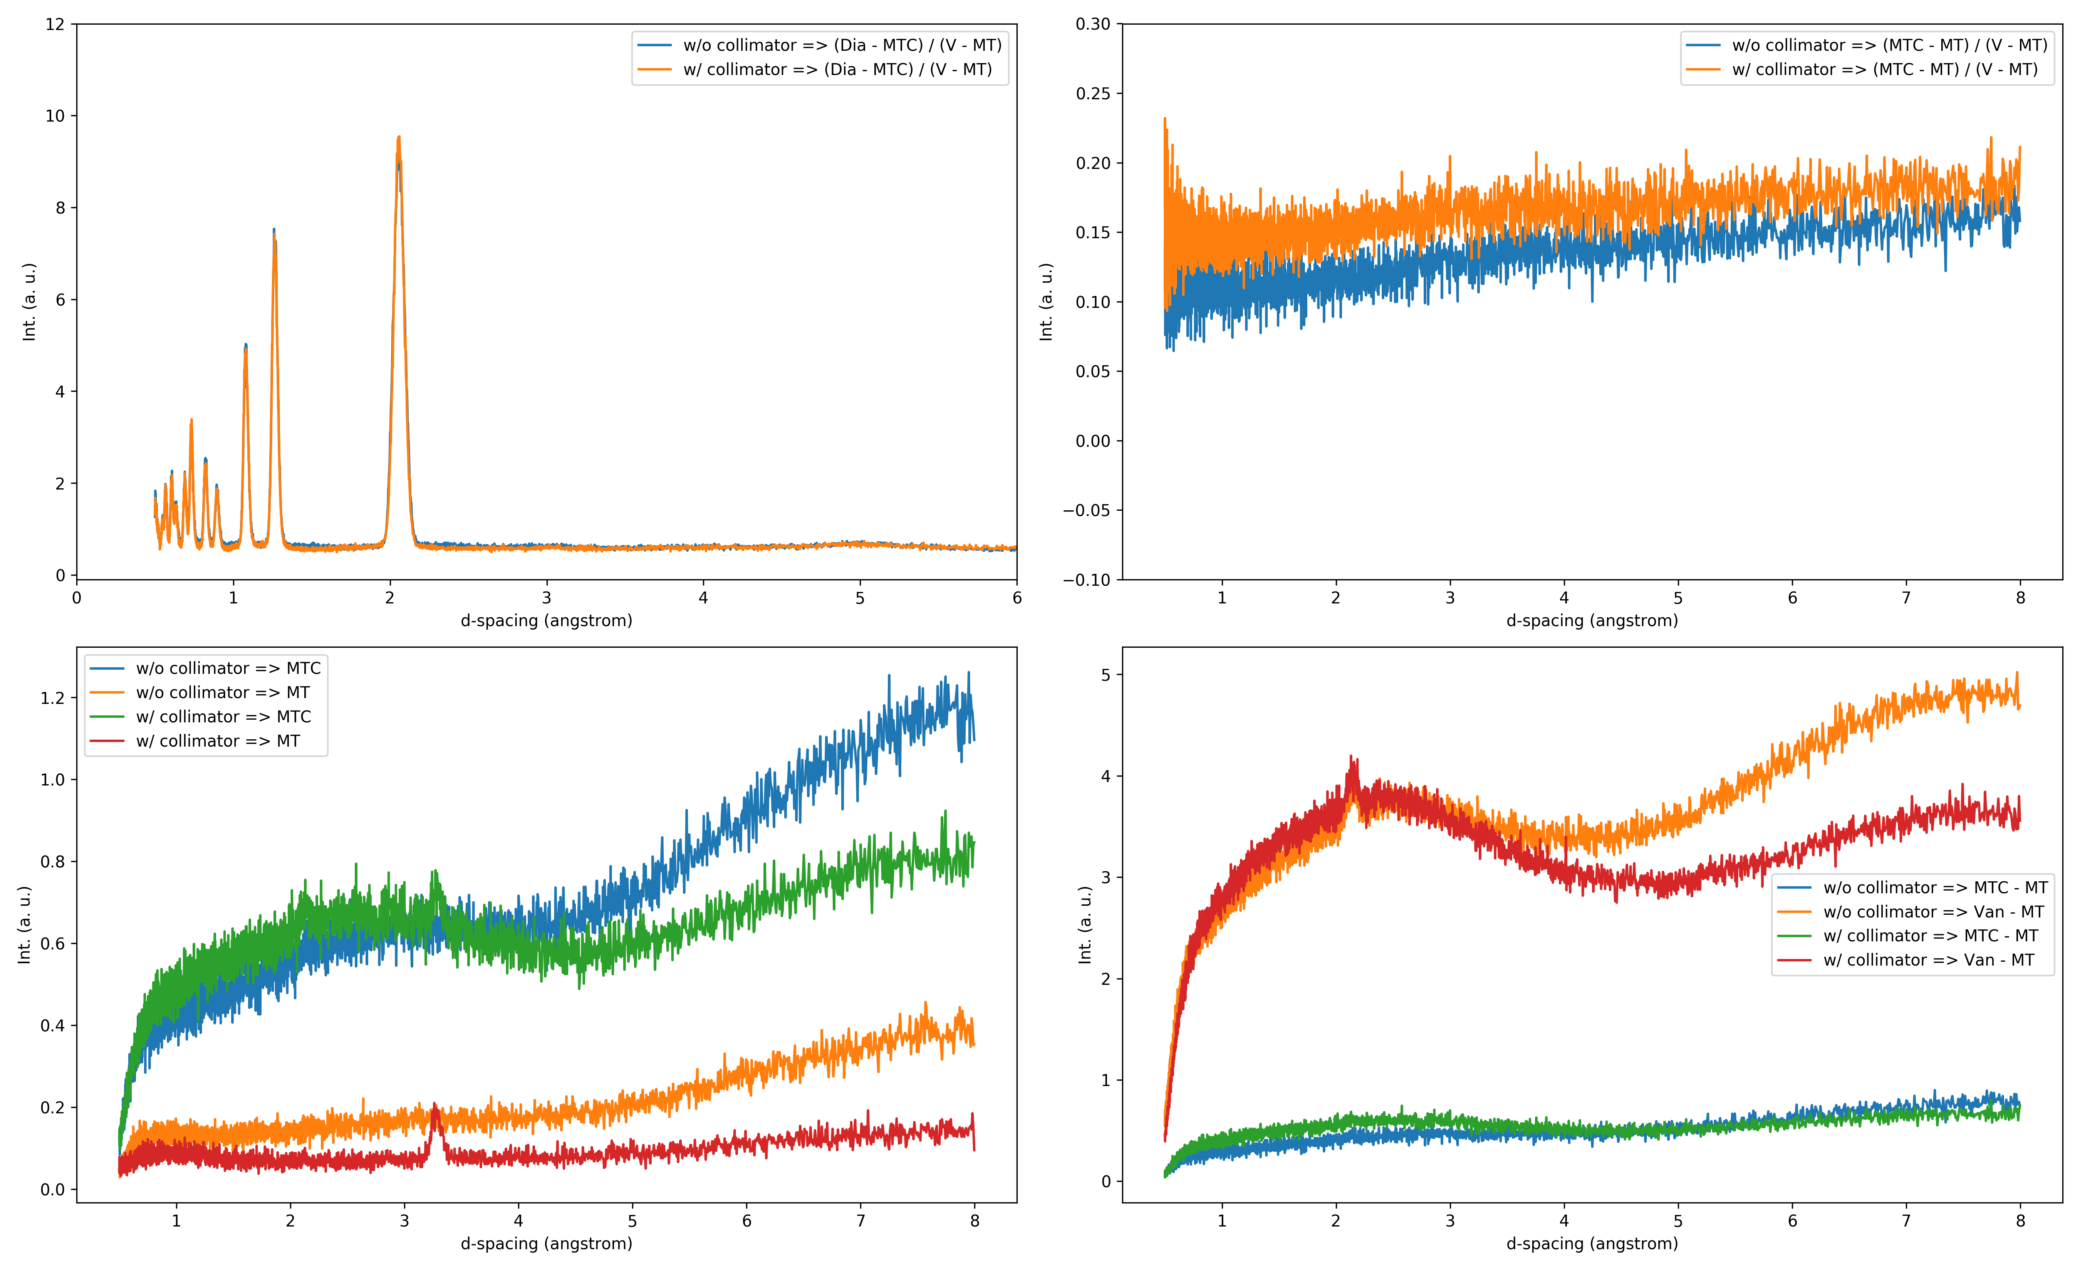
Focused eight-packs: #8 & #14 (bank-2)

Slide 17
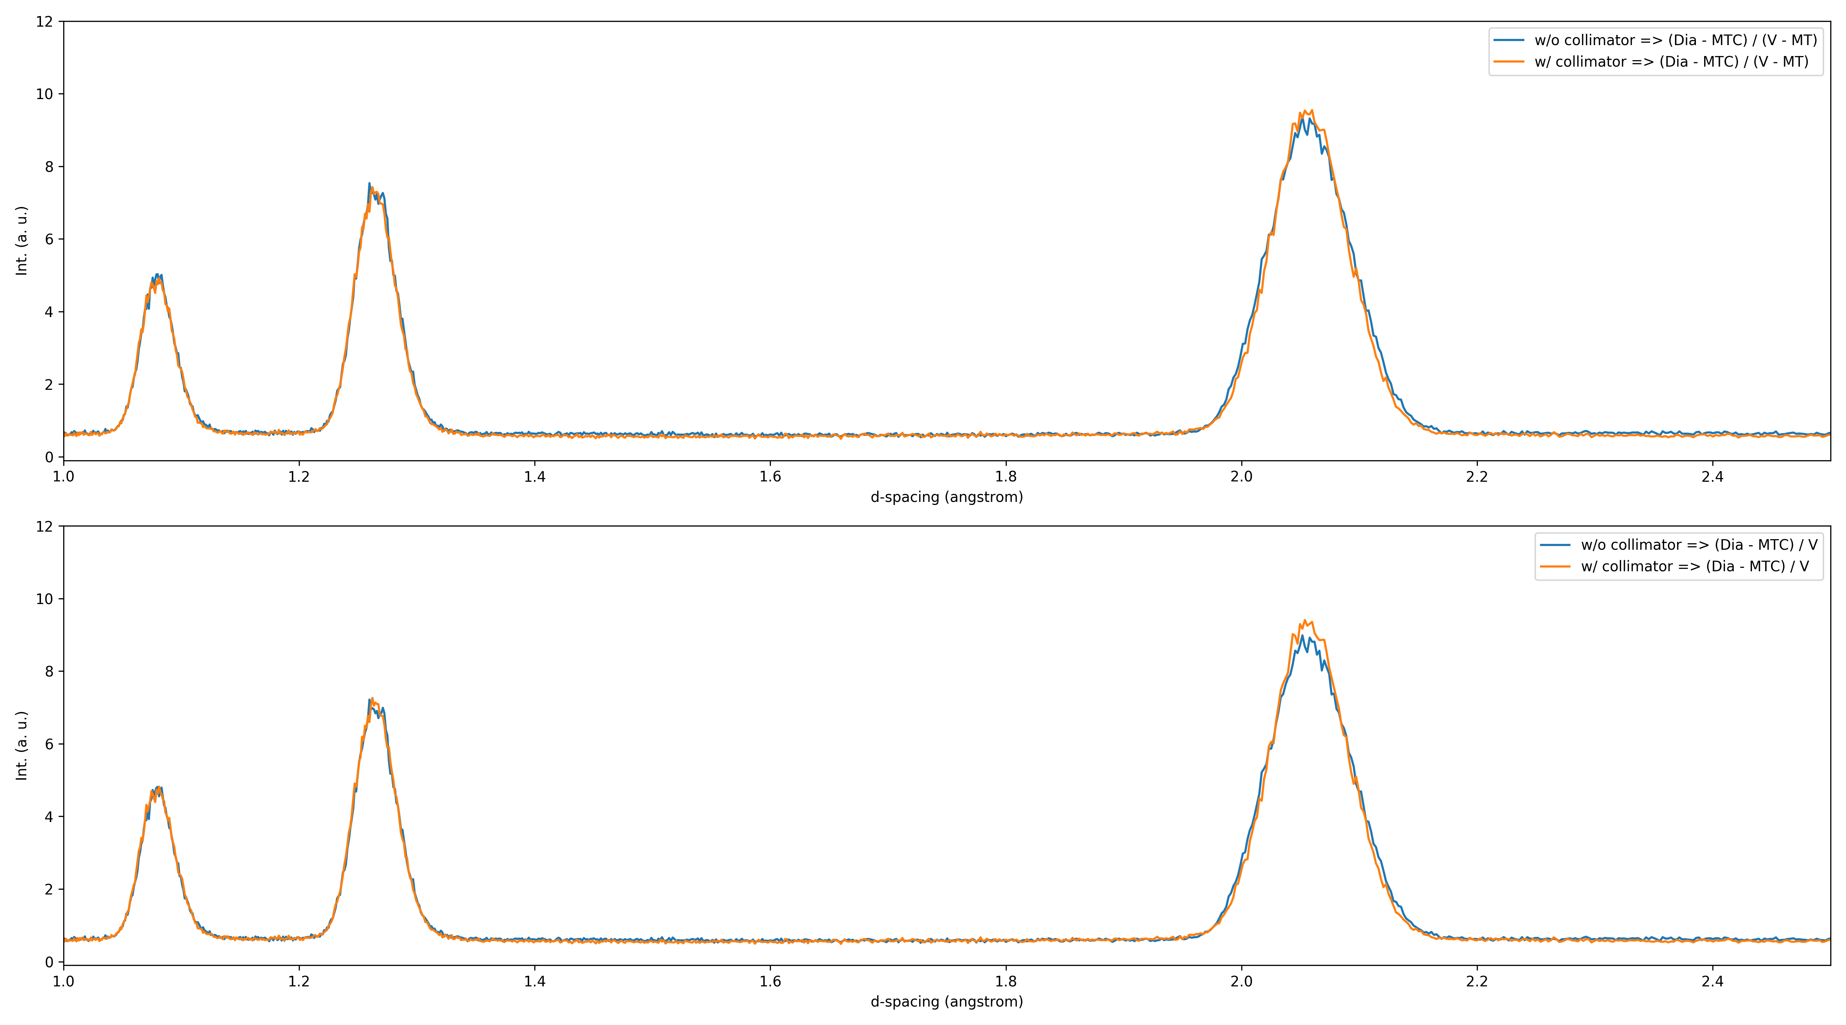
Focused eight-packs: #8 & #14 (bank-2)

Slide 18
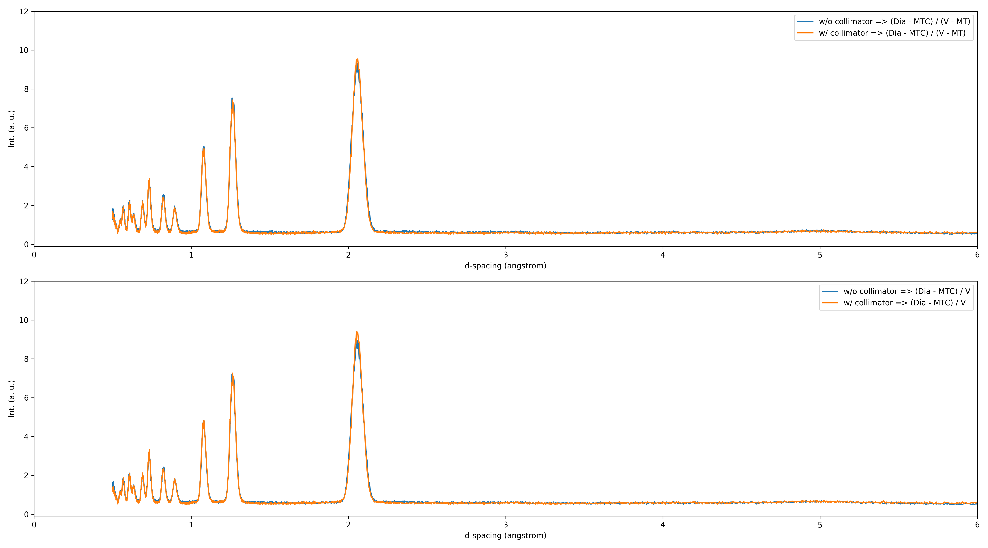
Focused eight-packs: #8 & #14 (bank-2)

Slide 19
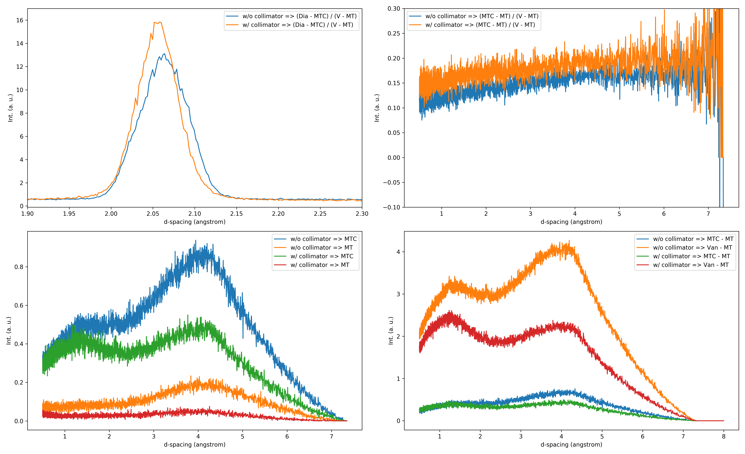
Focused eight-packs: #27 (bank-3)

Slide 20
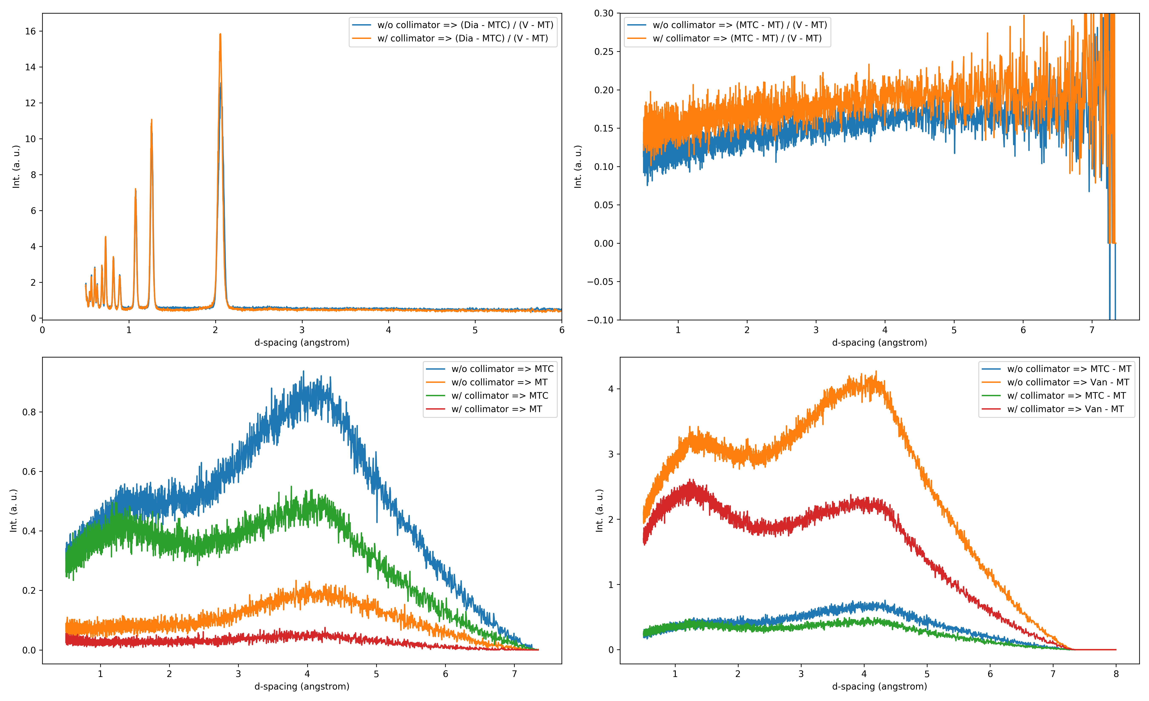
Focused eight-packs: #27 (bank-3)

Slide 21
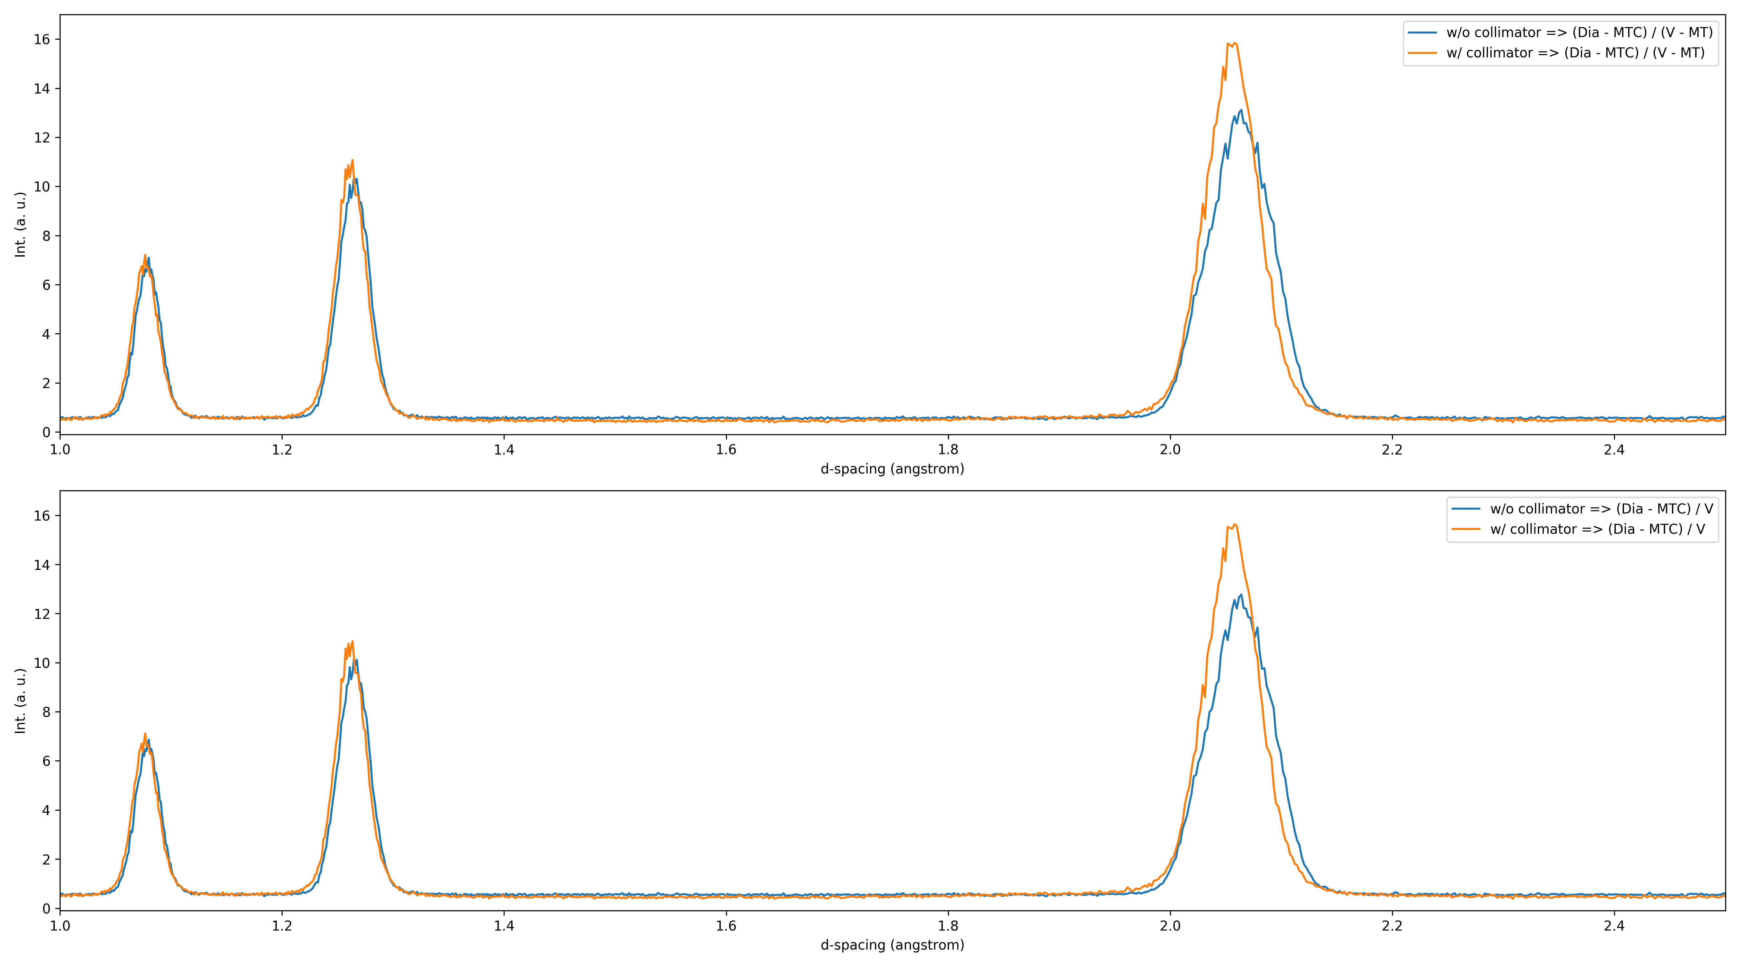
Focused eight-packs: #27 (bank-3)

Slide 22
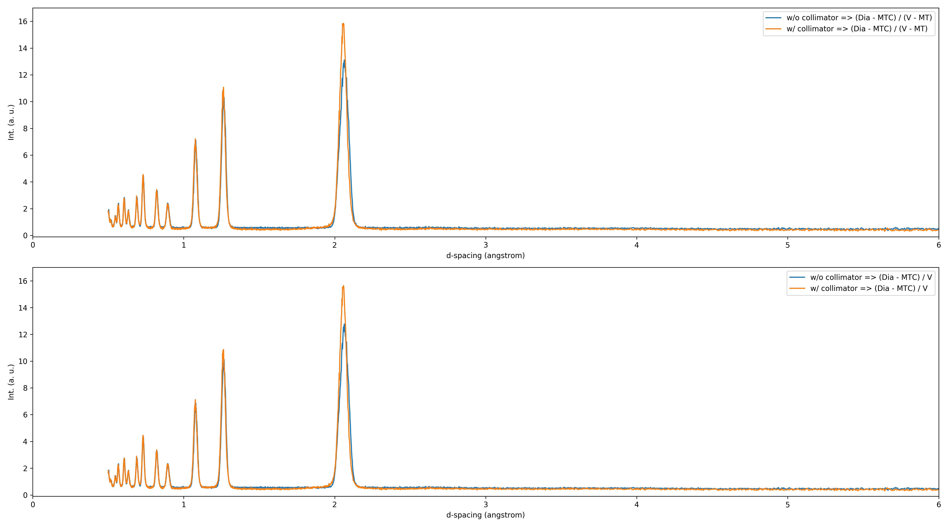
Focused eight-packs: #27 (bank-3)

Slide 23
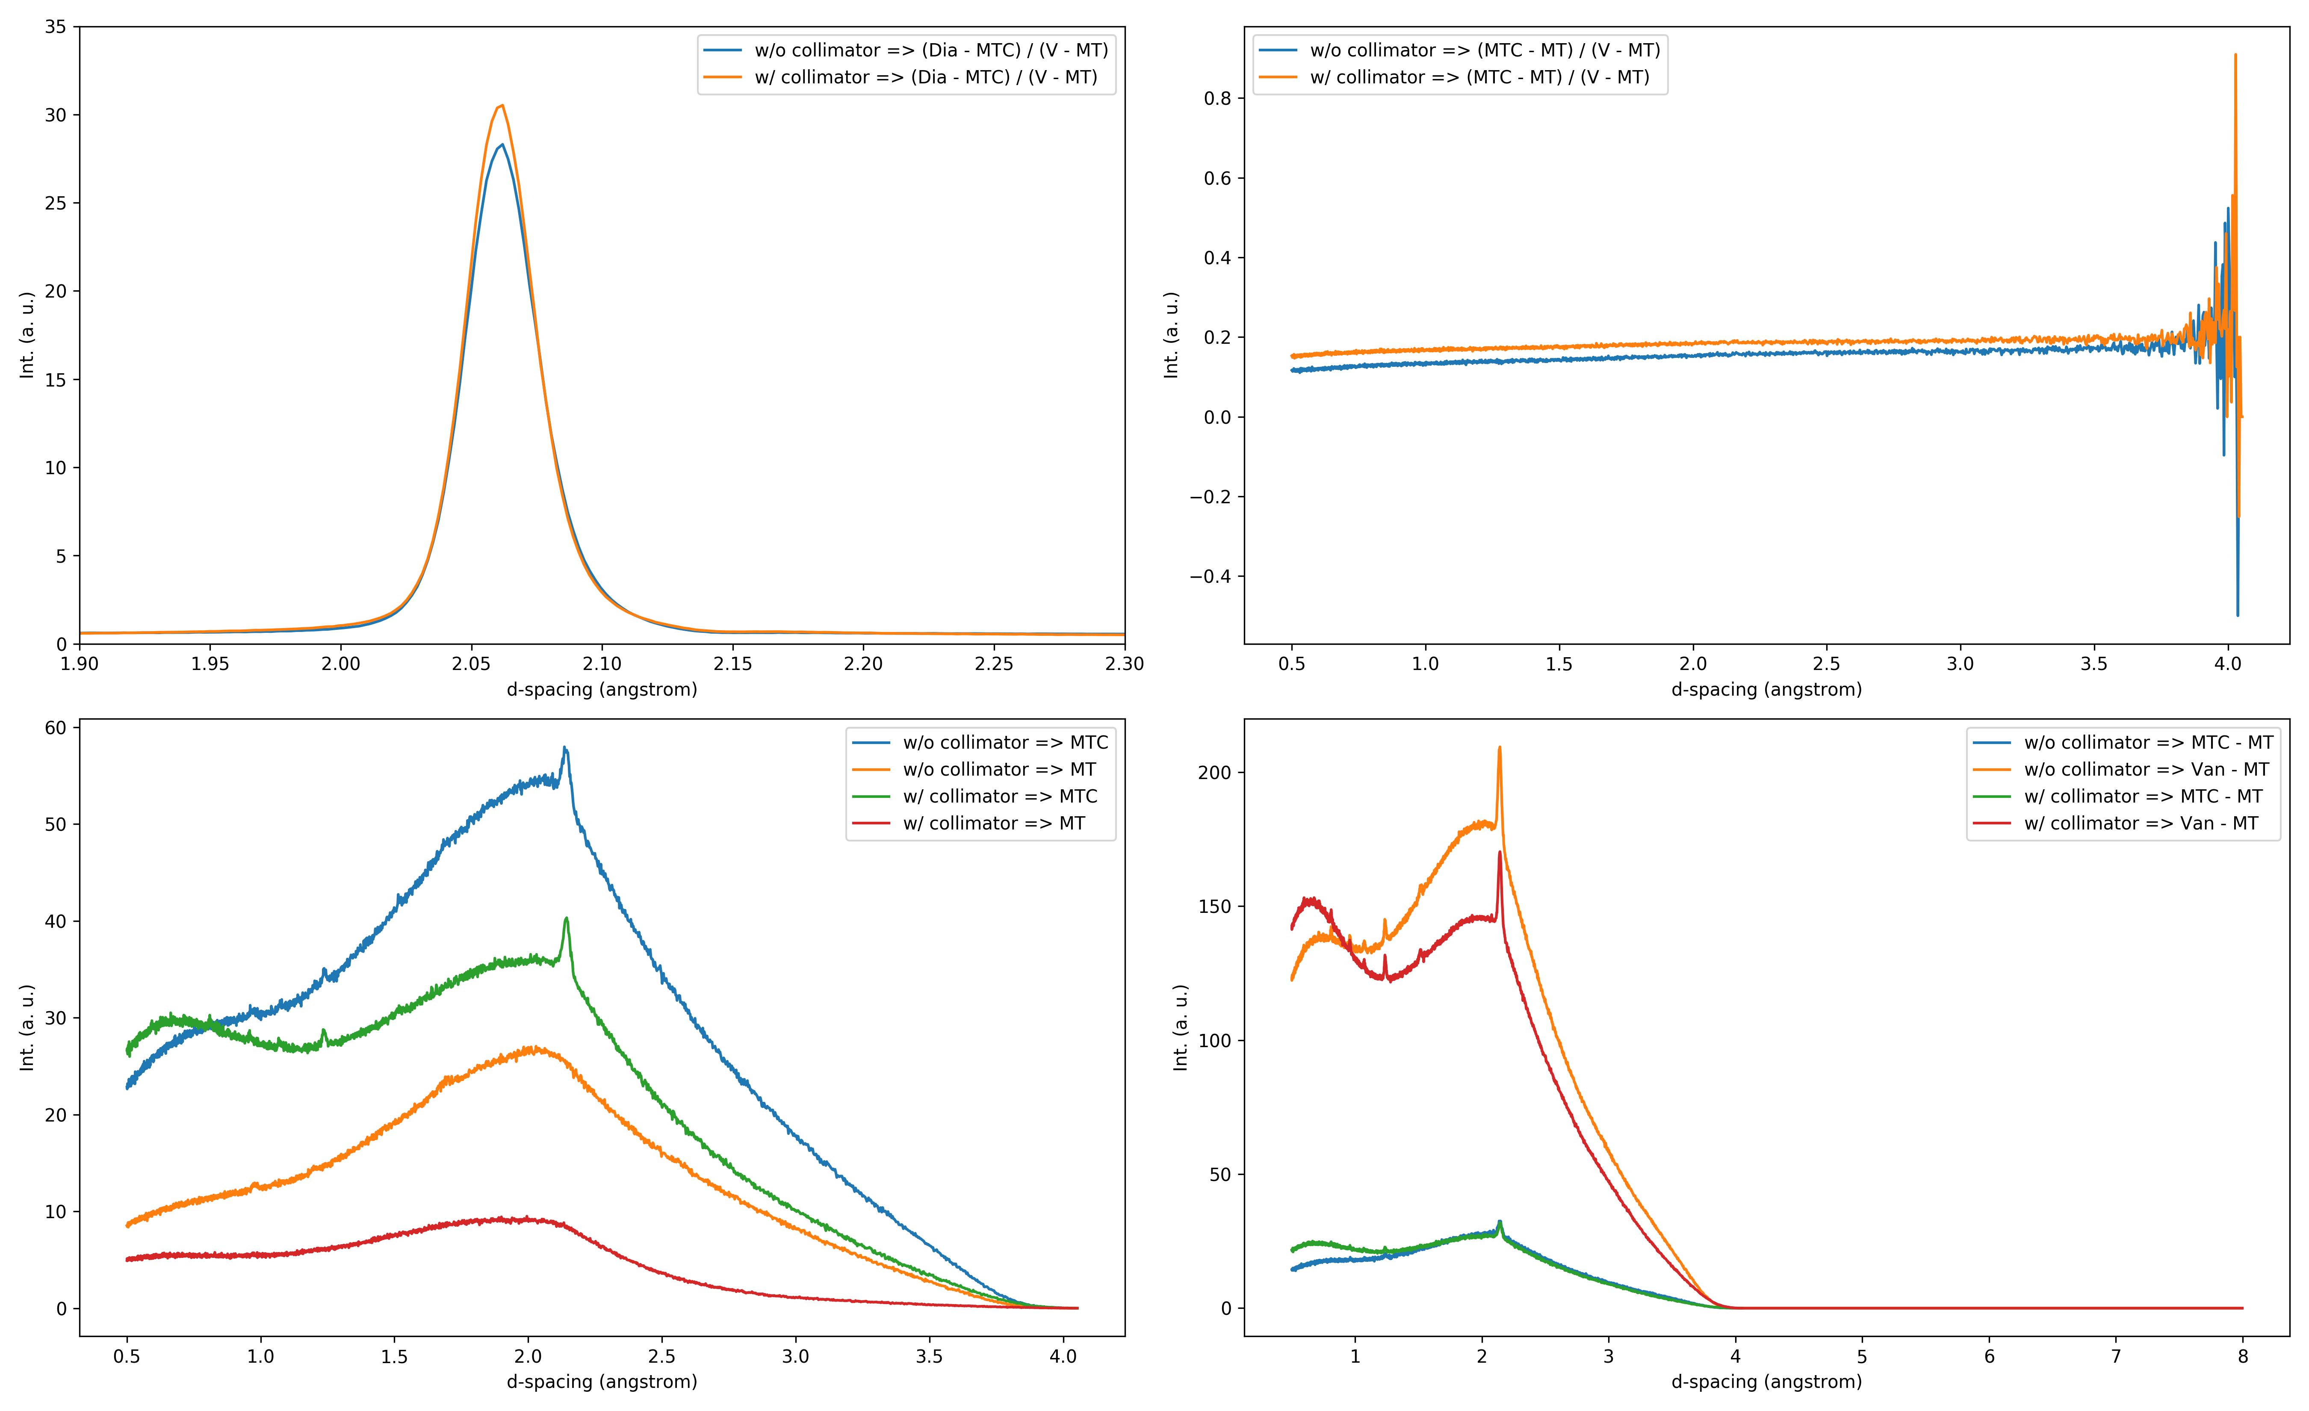
Focused eight-packs: #38-#51 (bank-4)

Slide 24
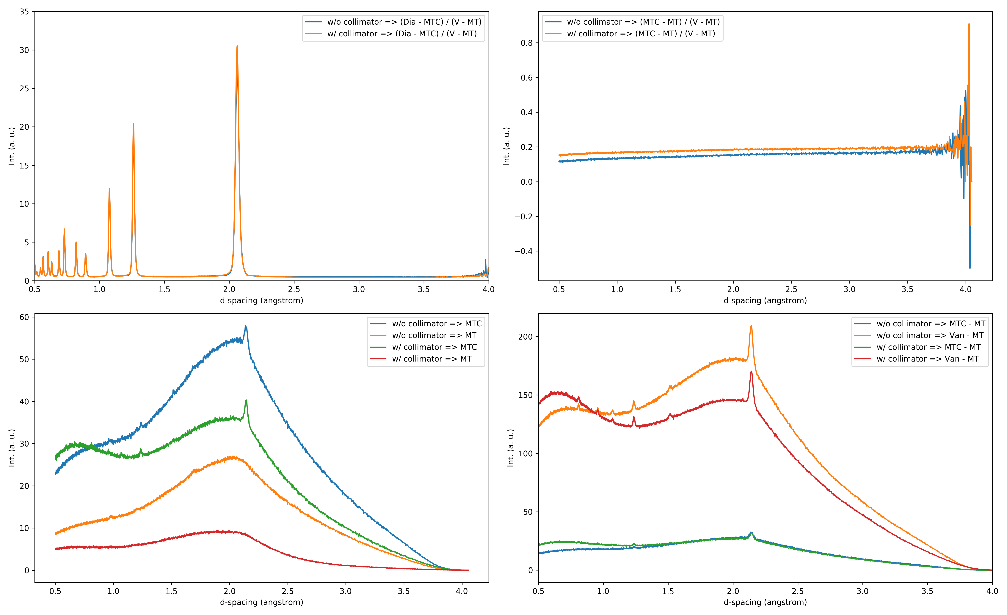
Focused eight-packs: #38-#51 (bank-4)

Slide 25
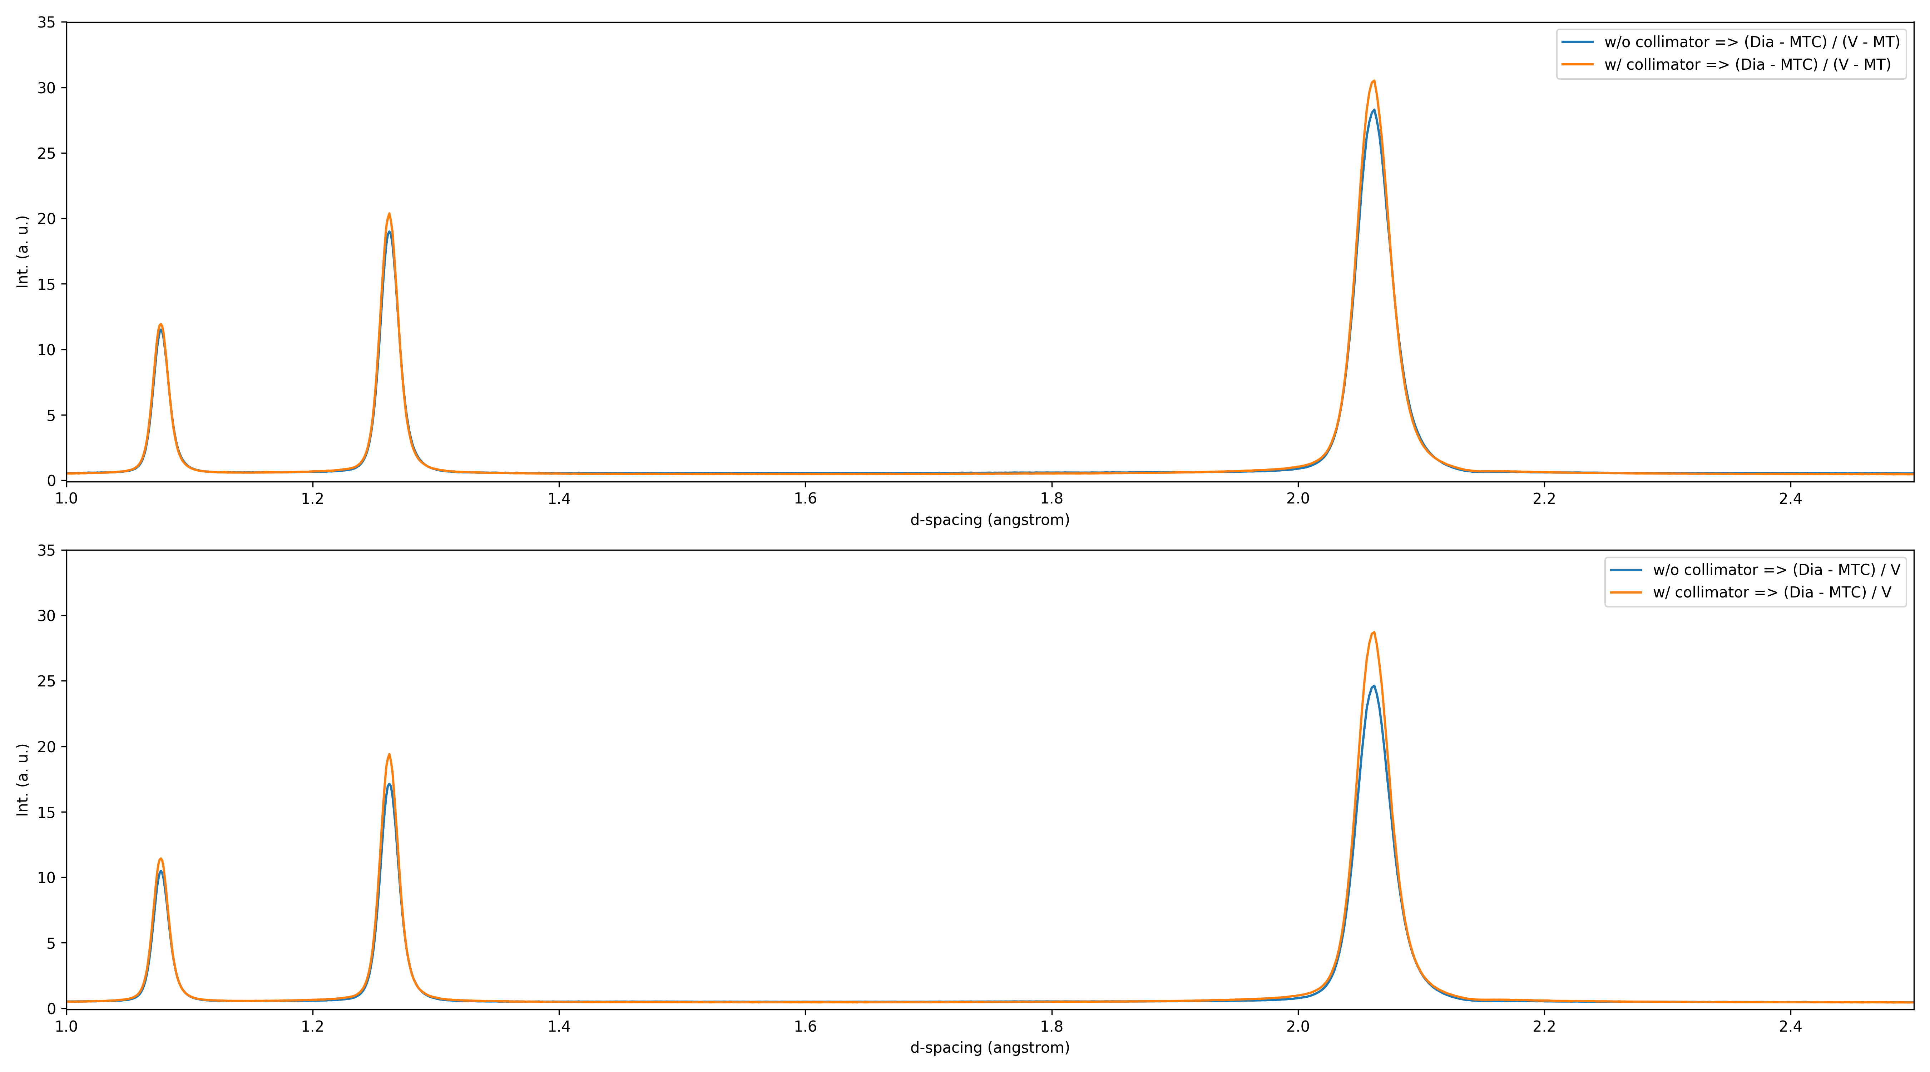
Focused eight-packs: #38-#51 (bank-4)

Slide 26
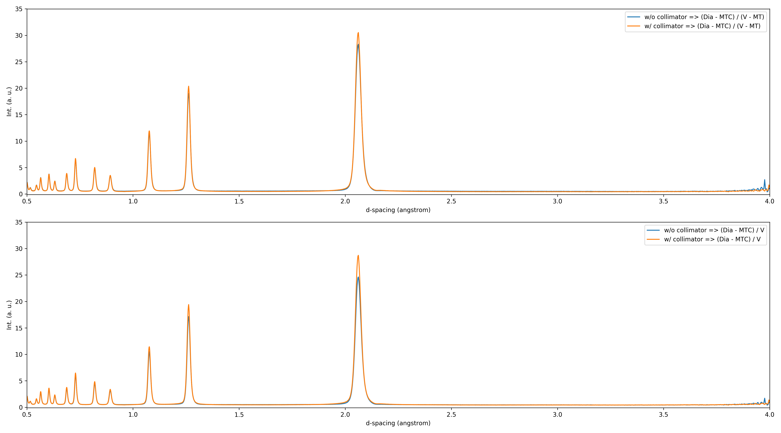
Focused eight-packs: #38-#51 (bank-4)

Slide 27
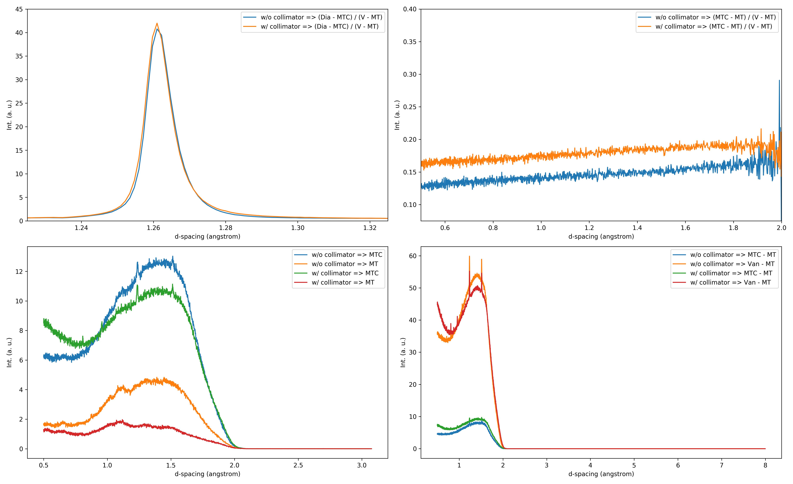
Focused eight-packs: #52-#57 (bank-5)

Slide 28
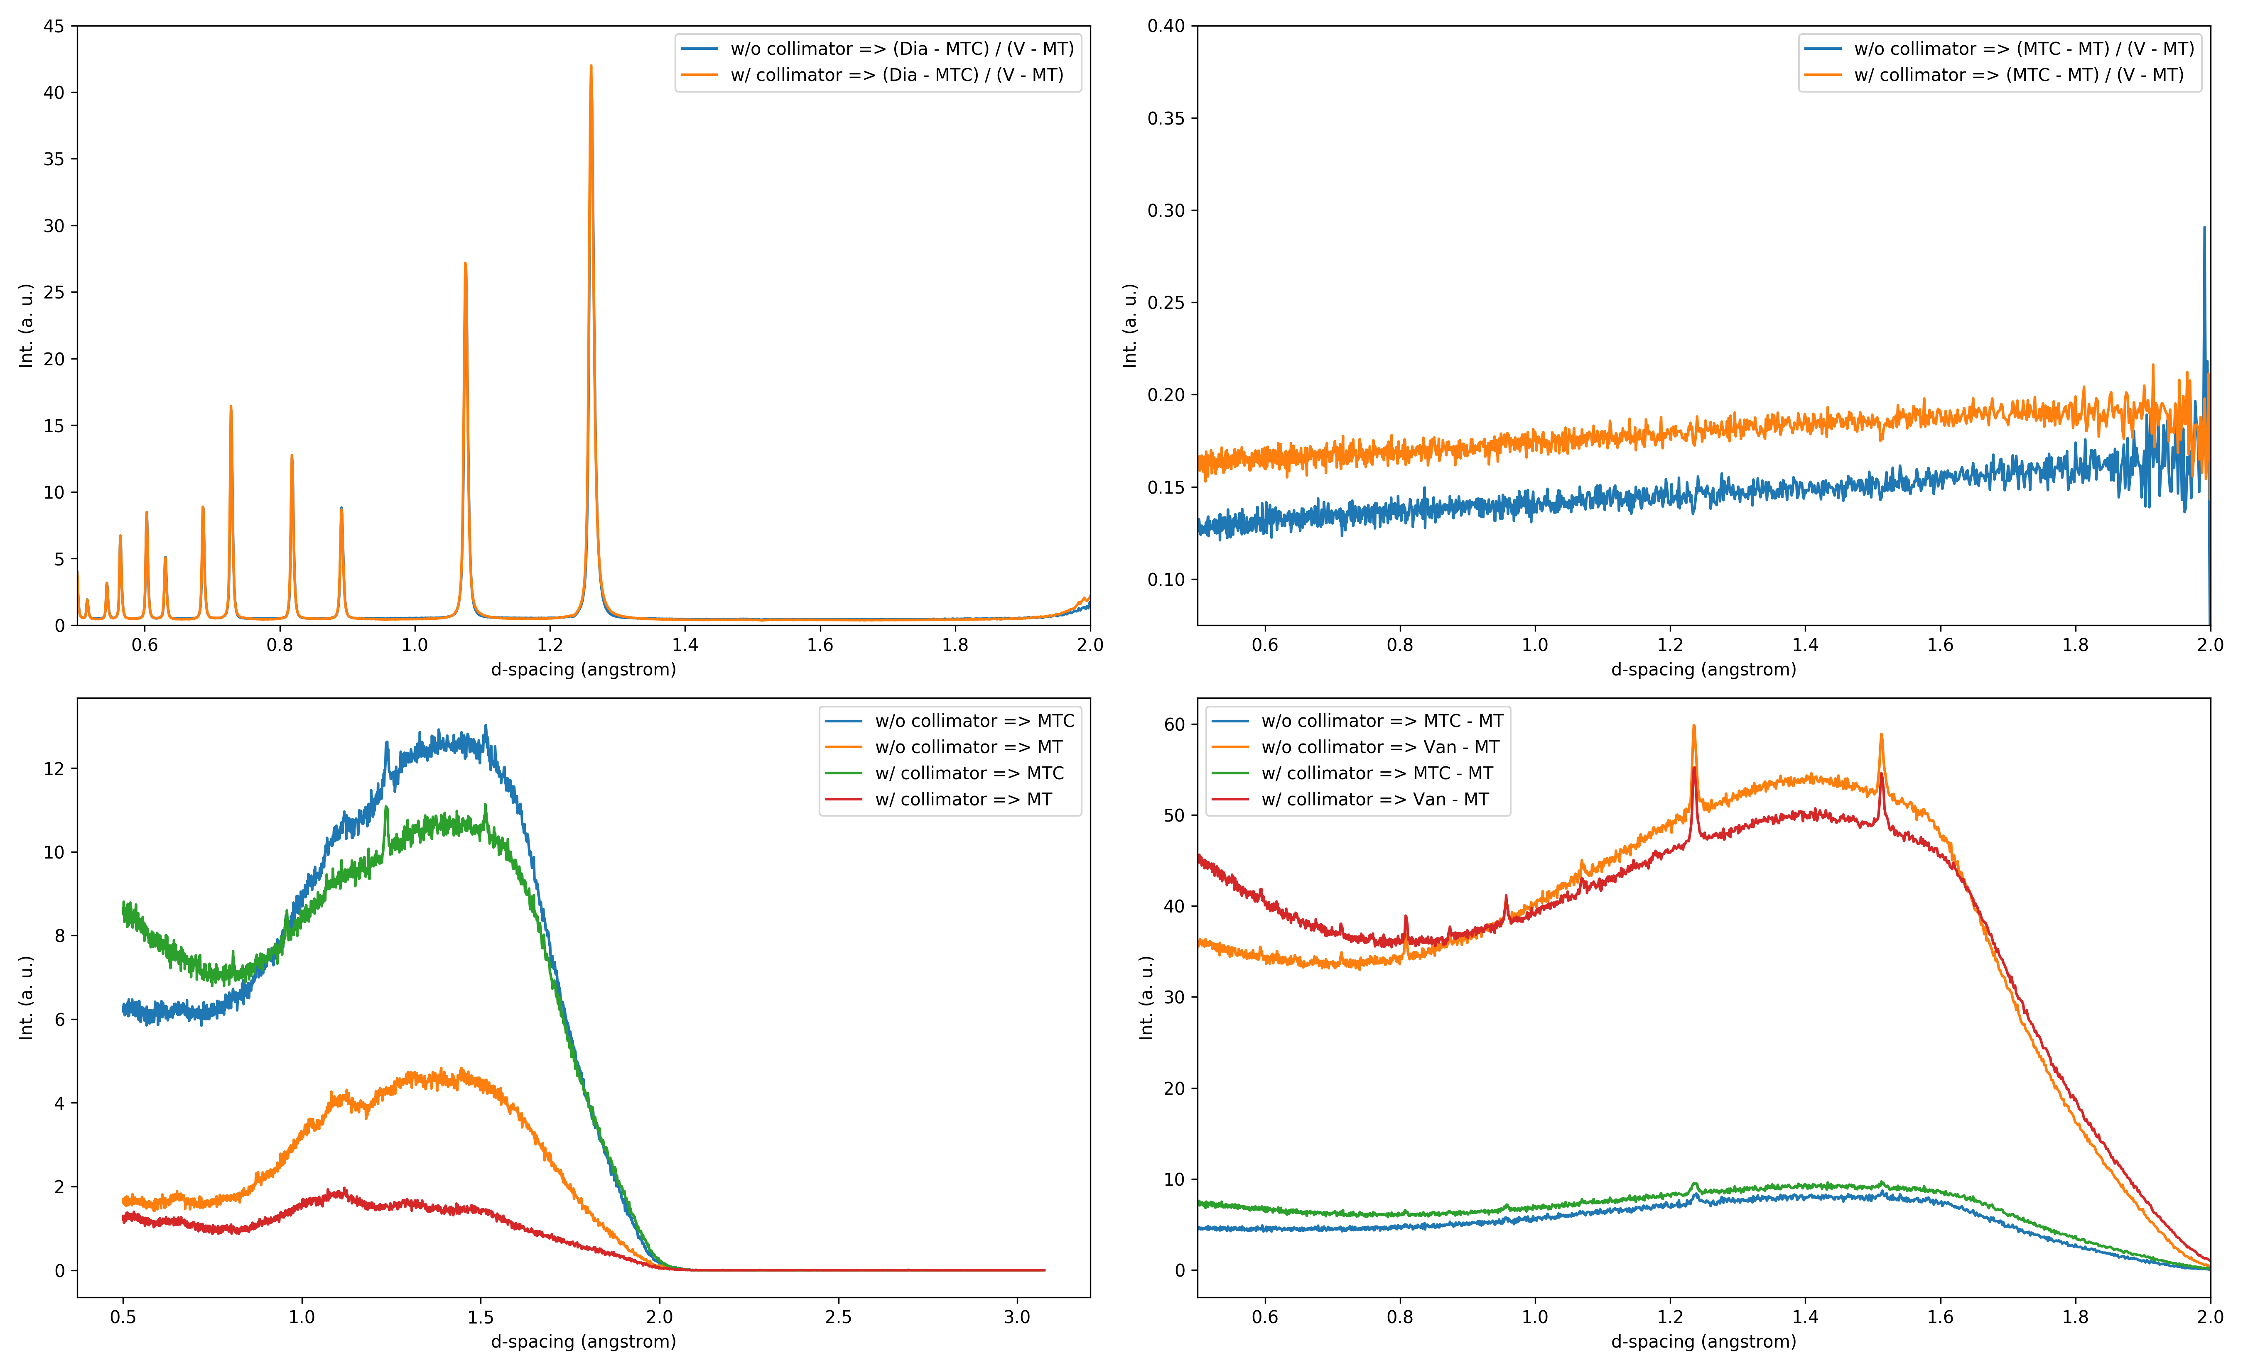
Focused eight-packs: #52-#57 (bank-5)

Slide 29
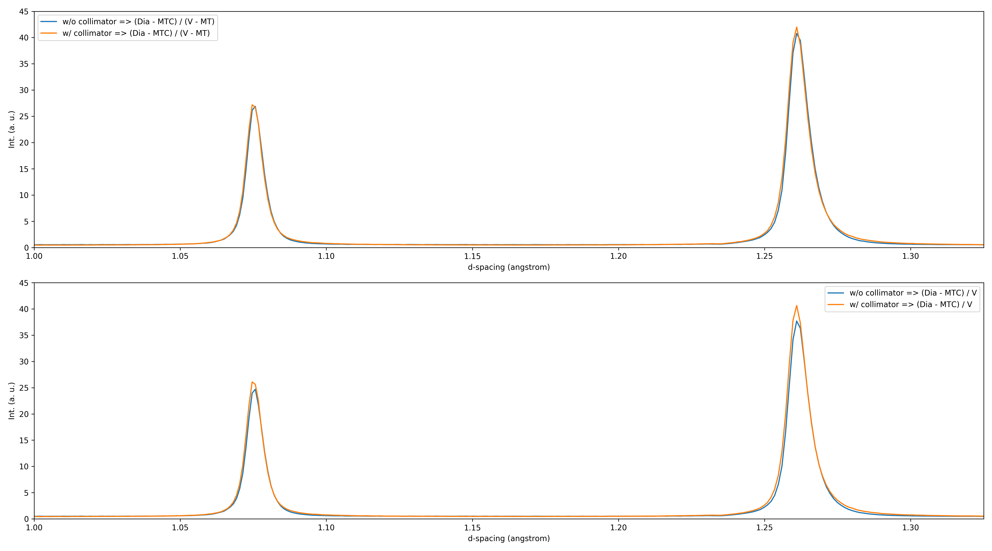
Focused eight-packs: #52-#57 (bank-5)

Slide 30
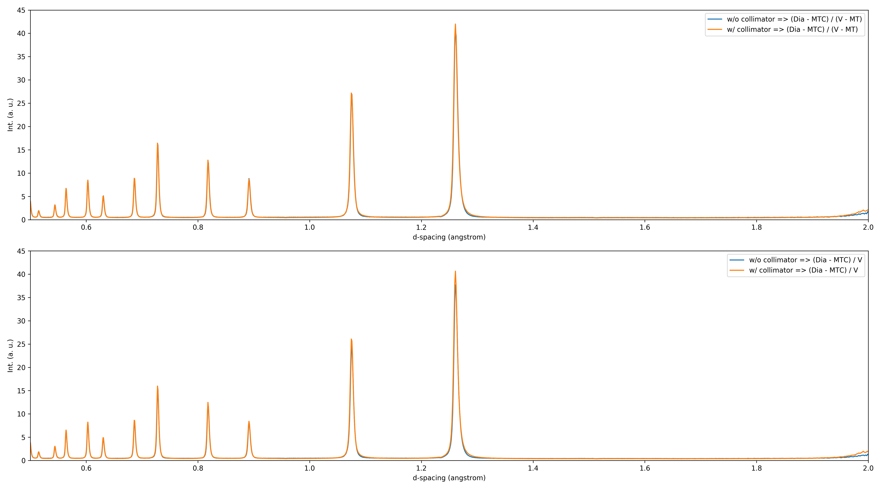
Focused eight-packs: #52-#57 (bank-5)

Slide 31
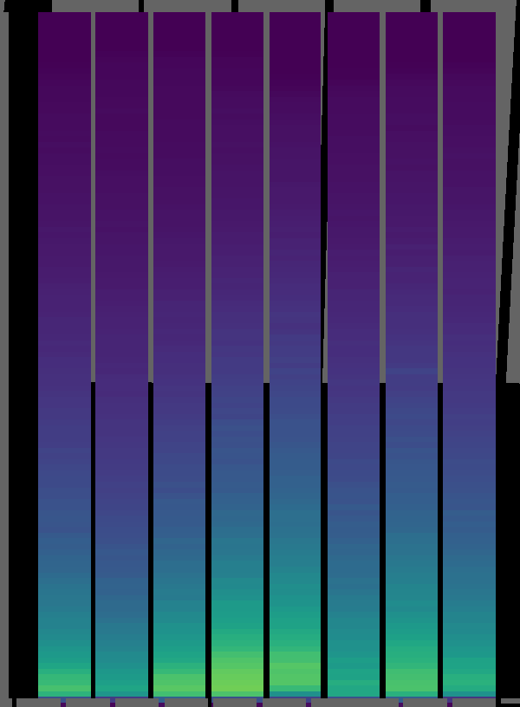
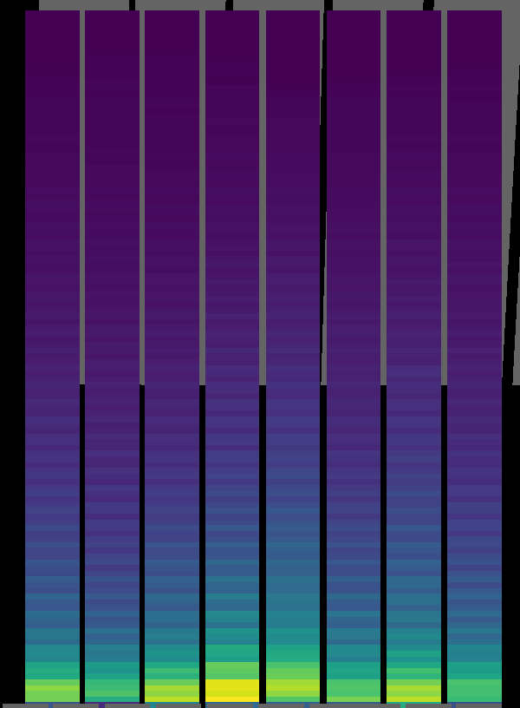
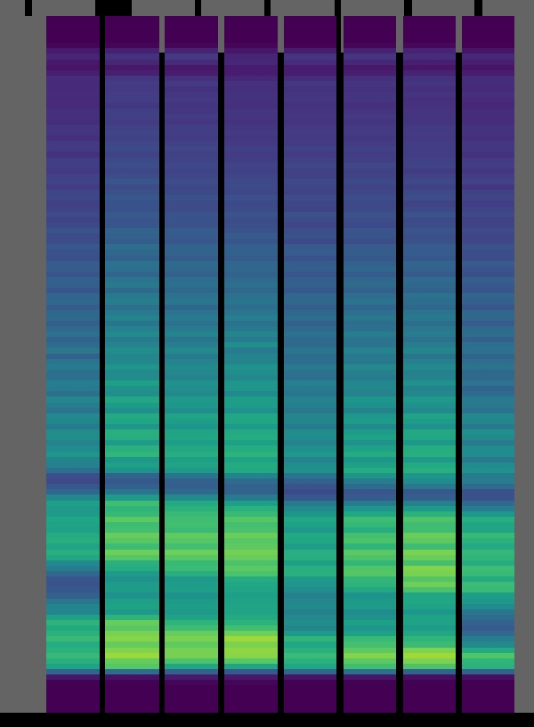
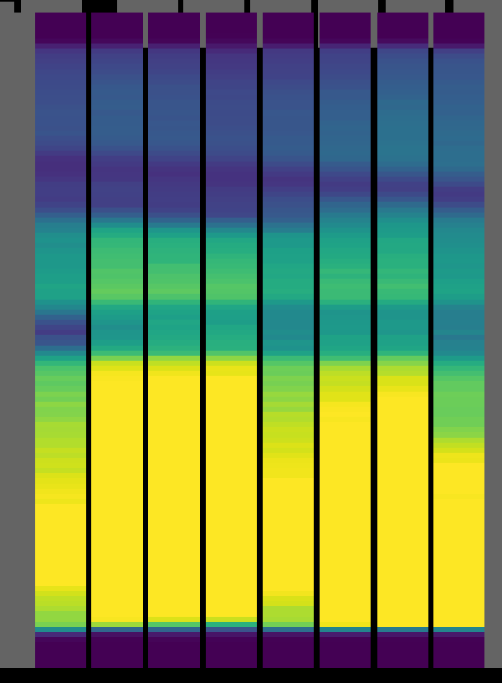
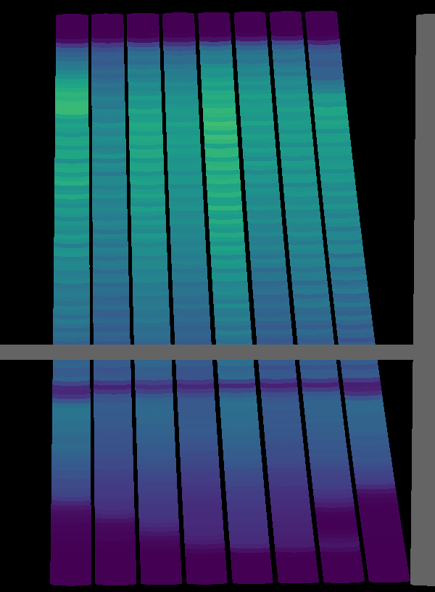
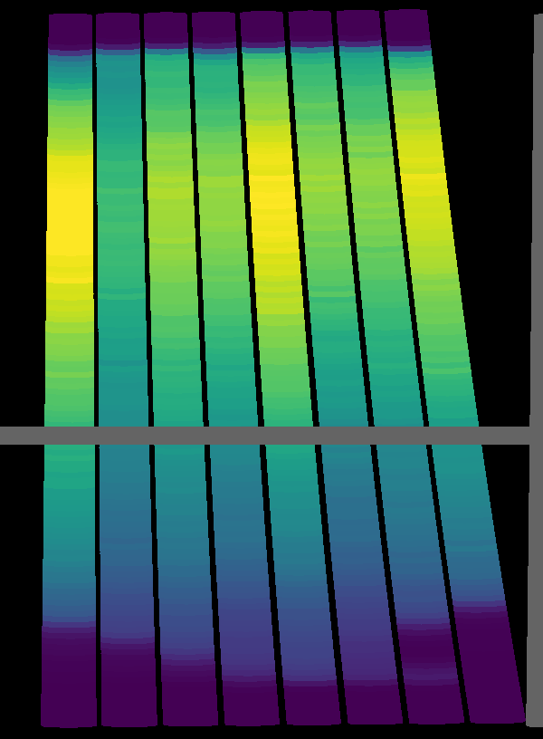
w/ collimator
w/o collimator
w/ collimator
w/o collimator
Eight-pack #33
Eight-pack #49
w/ collimator
w/o collimator
Eight-pack #58

Slide 32
Cryostat Results

Slide 33
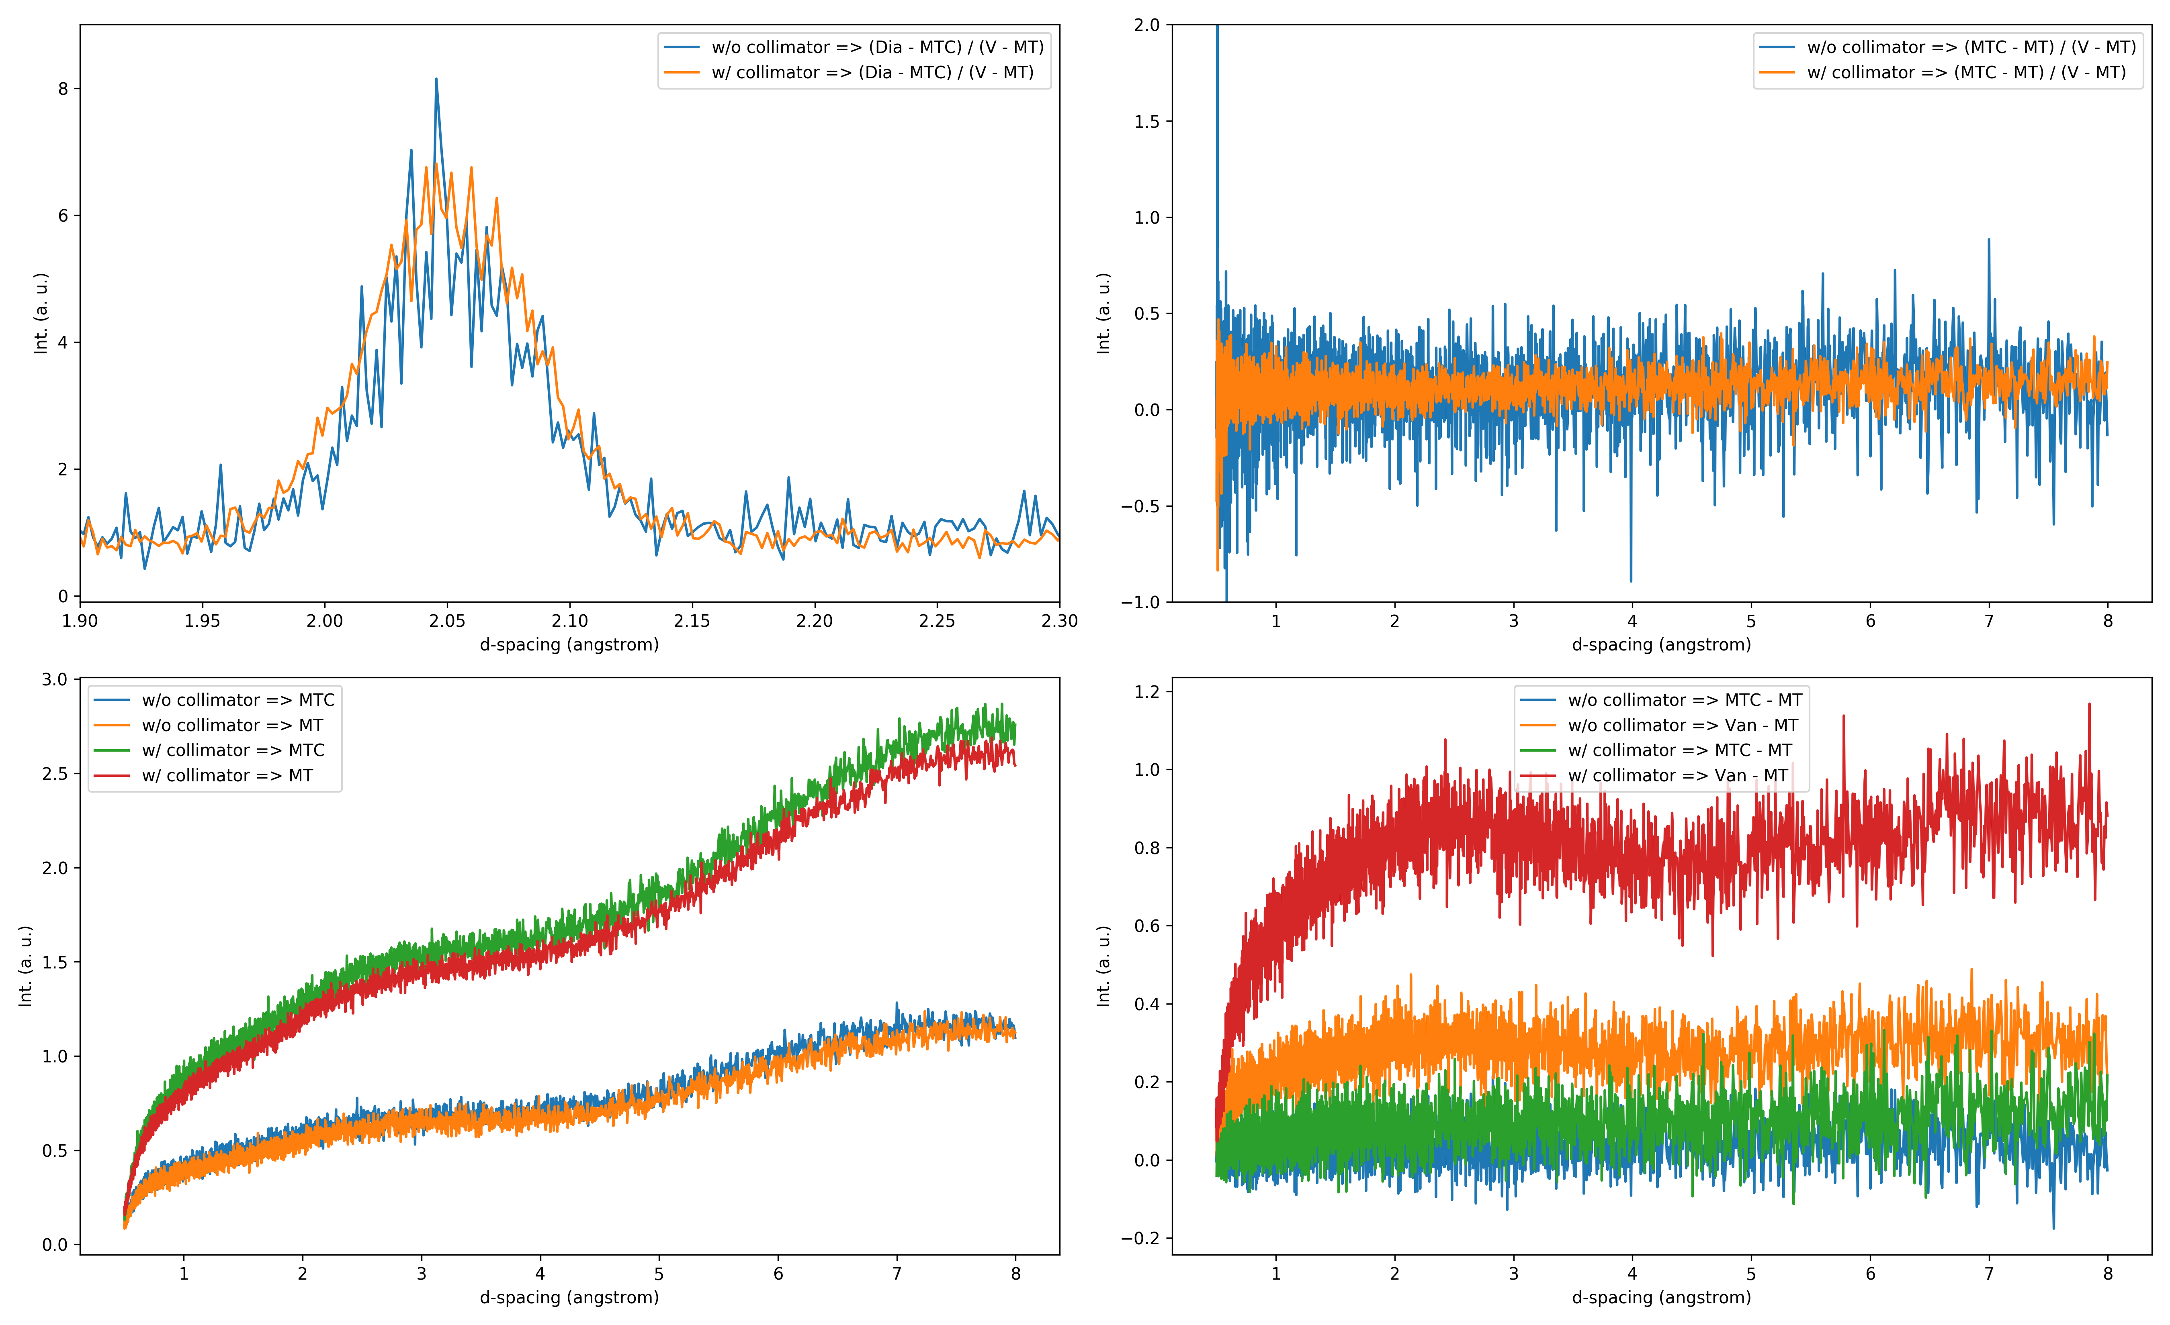
Focused eight-packs: #8 & #14 (bank-2)
Notes:
Top: diamond / Vrod & MTC / Vrod, before and after collimators installed.
Bottom: (diamond - MTC) / Vrod.
Left and right are the same plots shown in different region.
Same applies across the plots in ALL slides.

Slide 34
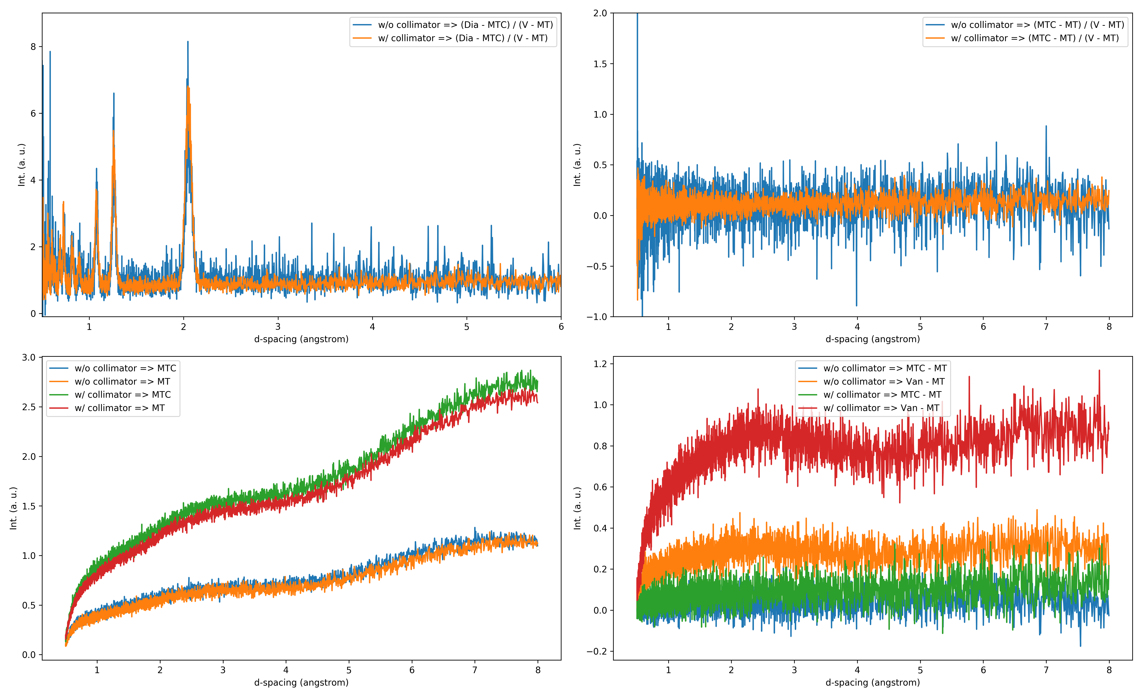
Focused eight-packs: #8 & #14 (bank-2)
Notes:
Top: diamond / Vrod & MTC / Vrod, before and after collimators installed.
Bottom: (diamond - MTC) / Vrod.
Left and right are the same plots shown in different region.
Same applies across the plots in ALL slides.

Slide 35
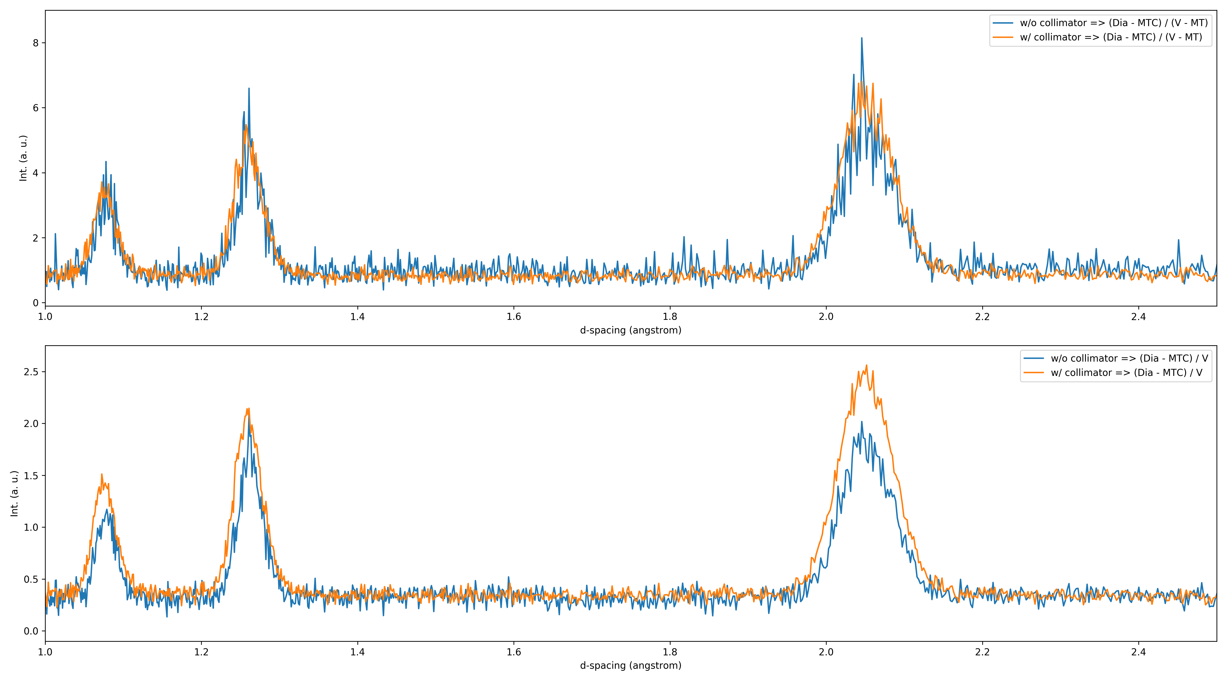
Focused eight-packs: #8 & #14 (bank-2)
Notes:
Top: diamond / Vrod & MTC / Vrod, before and after collimators installed.
Bottom: (diamond - MTC) / Vrod.
Left and right are the same plots shown in different region.
Same applies across the plots in ALL slides.

Slide 36
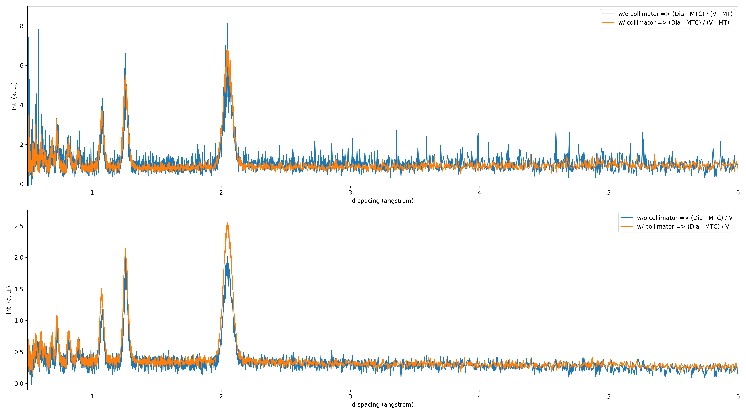
Focused eight-packs: #8 & #14 (bank-2)
Notes:
Top: diamond / Vrod & MTC / Vrod, before and after collimators installed.
Bottom: (diamond - MTC) / Vrod.
Left and right are the same plots shown in different region.
Same applies across the plots in ALL slides.

Slide 37
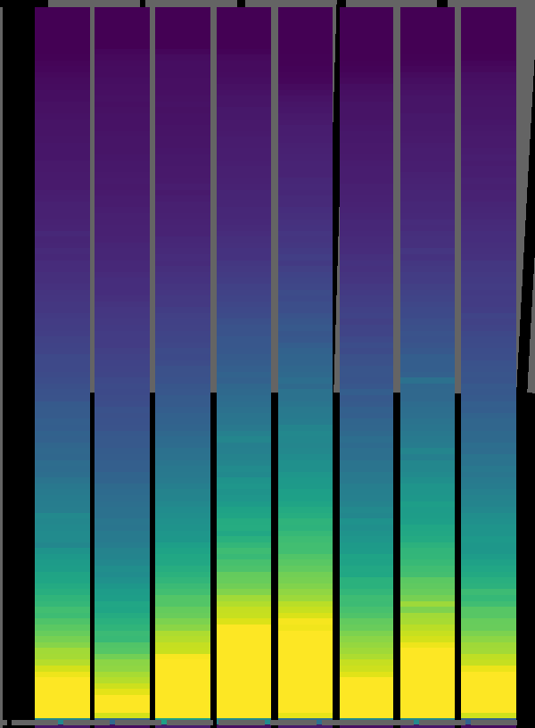
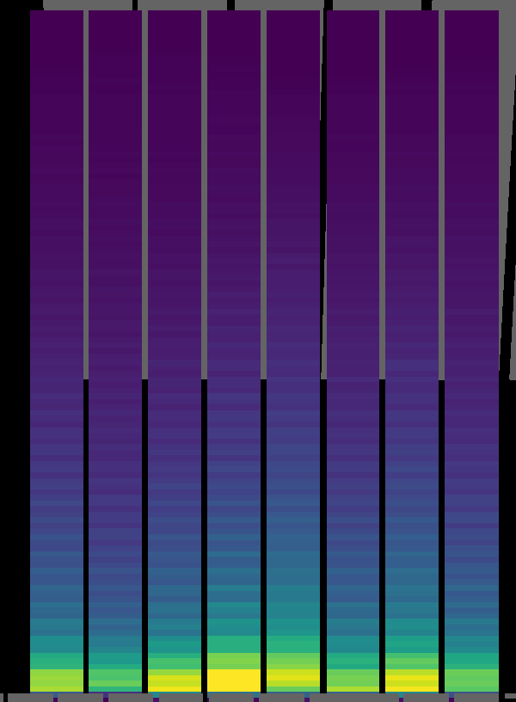
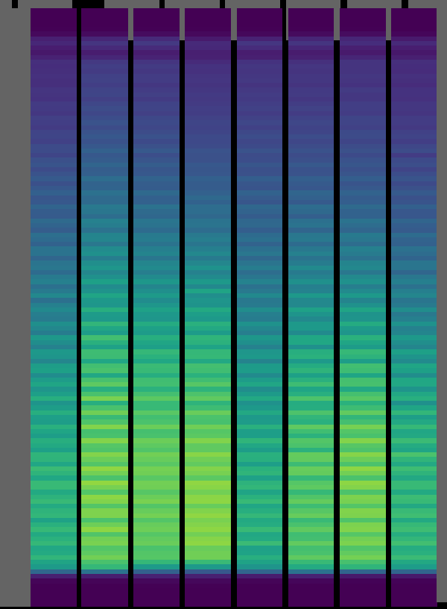
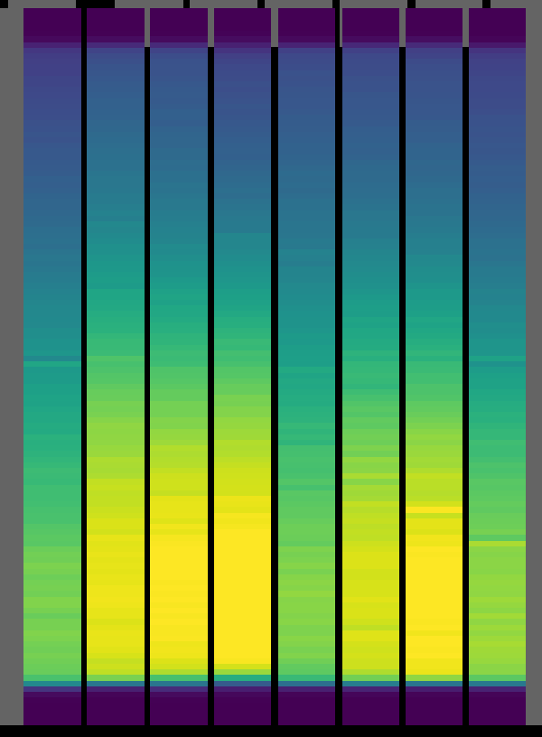
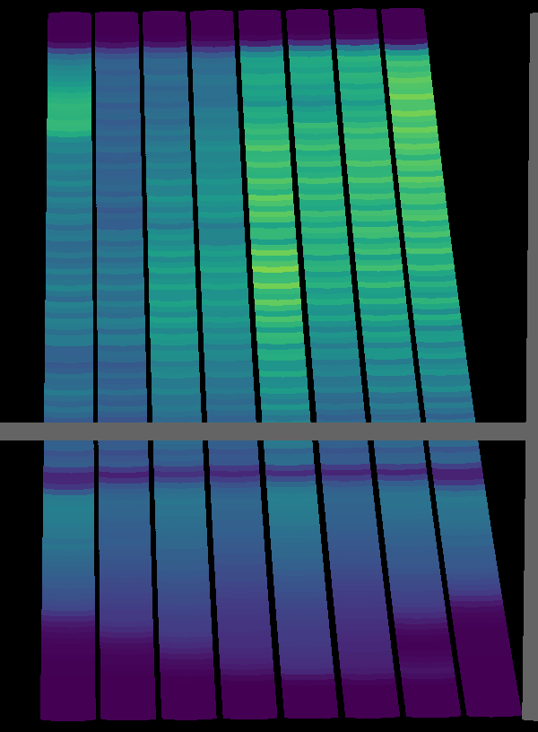
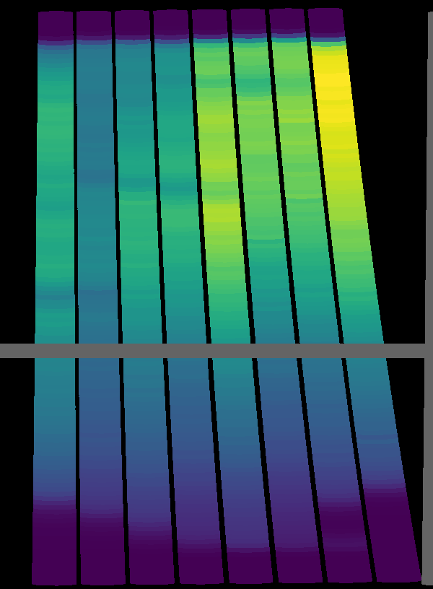
w/ collimator
w/o collimator
w/ collimator
w/o collimator
Eight-pack #33
Eight-pack #49
w/ collimator
w/o collimator
Eight-pack #58

